Slide 1


INDIVIDUAL ASSIGNMENT w9w10
INTERMEDIATE & ADVANCED
W9W10 FSDA Barcelona
Adytia Putra Pradana

Slide 2




Background of Study
2
Data visualization is useful for data cleaning, exploring data structure, detecting outliers and unusual groups, identifying trends and clusters, spotting local patterns, evaluating modeling output, and presenting results. It is essential for exploratory data analysis and data mining to check data quality and to help analysts become familiar with the structure and features of the data before them. To test our capability in data visualization, we need to visualize some data in the intermediate and advanced assignment. I am going to use tableau public as a main data visualization tools. Other than using tableau, I also use Google Data Studio.
Tools Used
Data Visualization Process
Data Acquisition
Combining Data
Visualizing Data
Insights!

Slide 3

Intermediate
W9W10 FSDA Barcelona
Adytia Putra Pradana

Slide 4
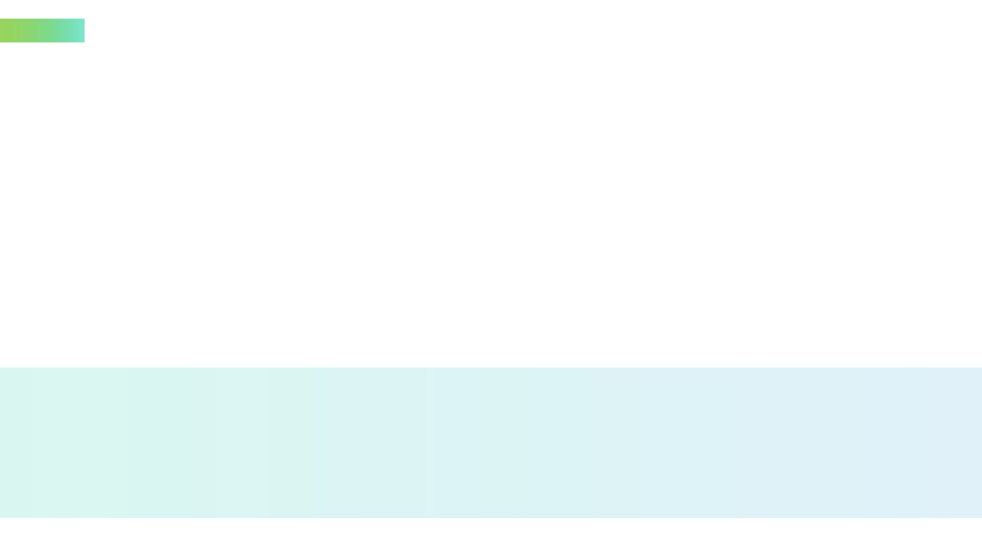
Data Acquisition
4
The dataset (order dataset) is from the previous dataset that used in the python assignment. The dataset consist of 6 tables
Dataset Source
orders_dataset
items_dataset
customers_dataset
order_payments_dataset
products_dataset
product_category_name_translate

Slide 5
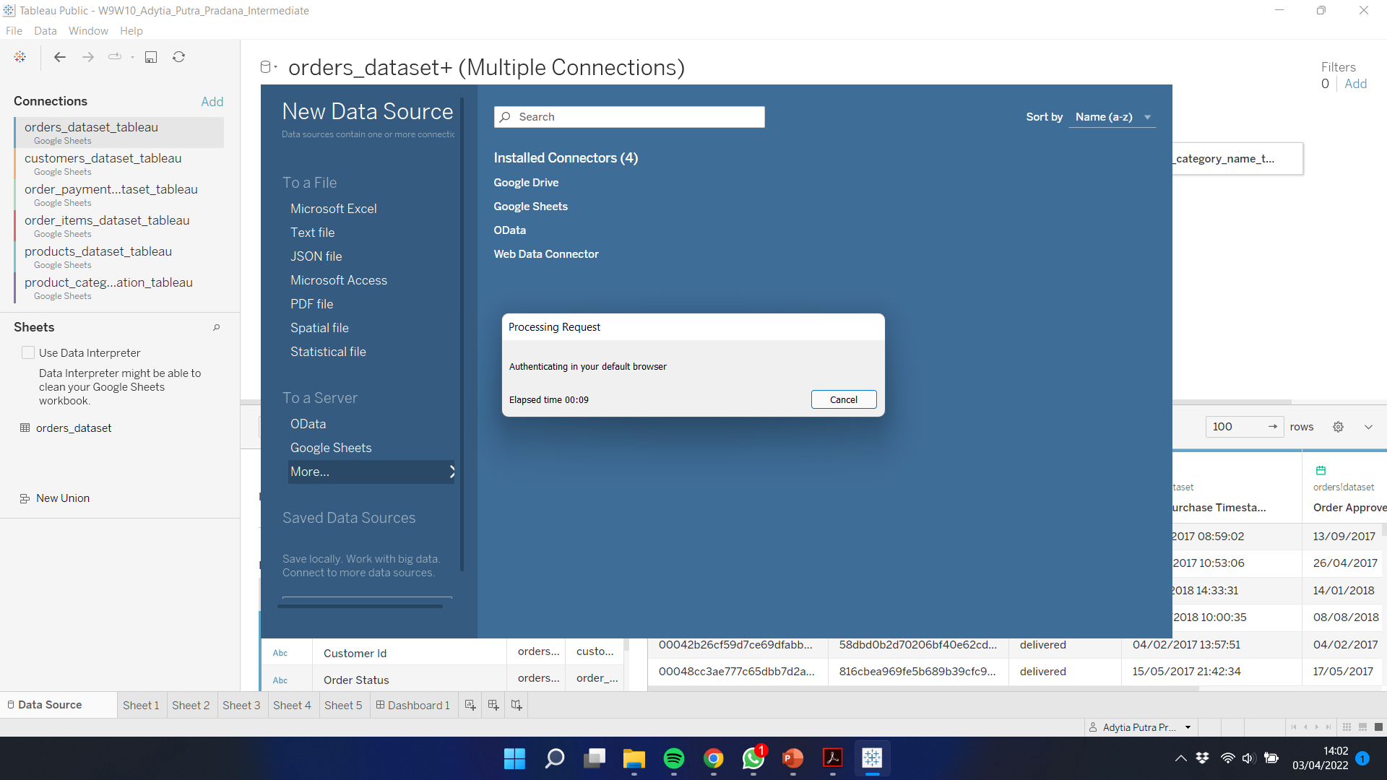
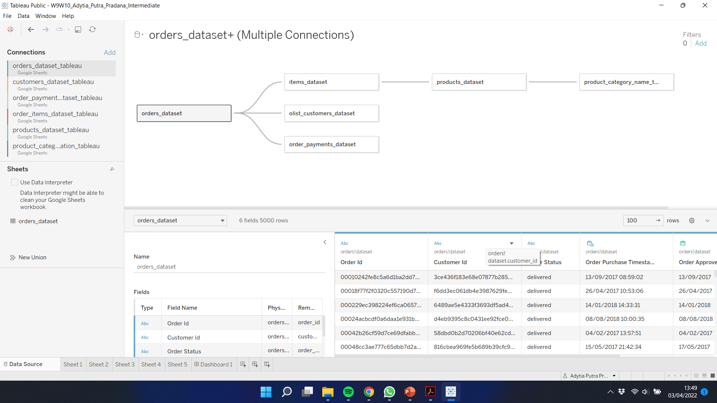
Combining Data
5
Data Combination Process
Before performing data visualization, the available datasets are first connected to the tableau application via google sheets. Once connected, each dataset is combined (JOIN) by determining the relationship between the datasets through the primary key of the dataset.
!

Slide 6

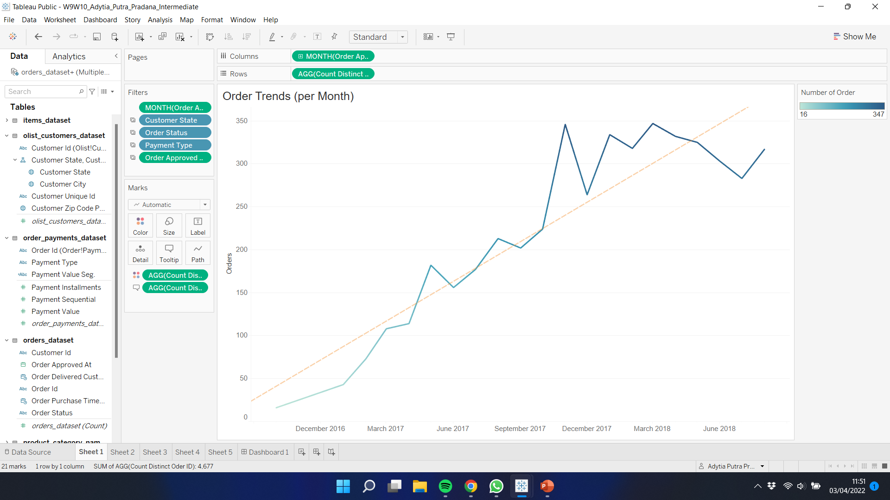
#1 – Number of Orders per Month
6
From October 2016 – August 2018, the number of orders experienced an upward trend. The number of orders reached its peak in March 2018 with 347 orders.

Slide 7

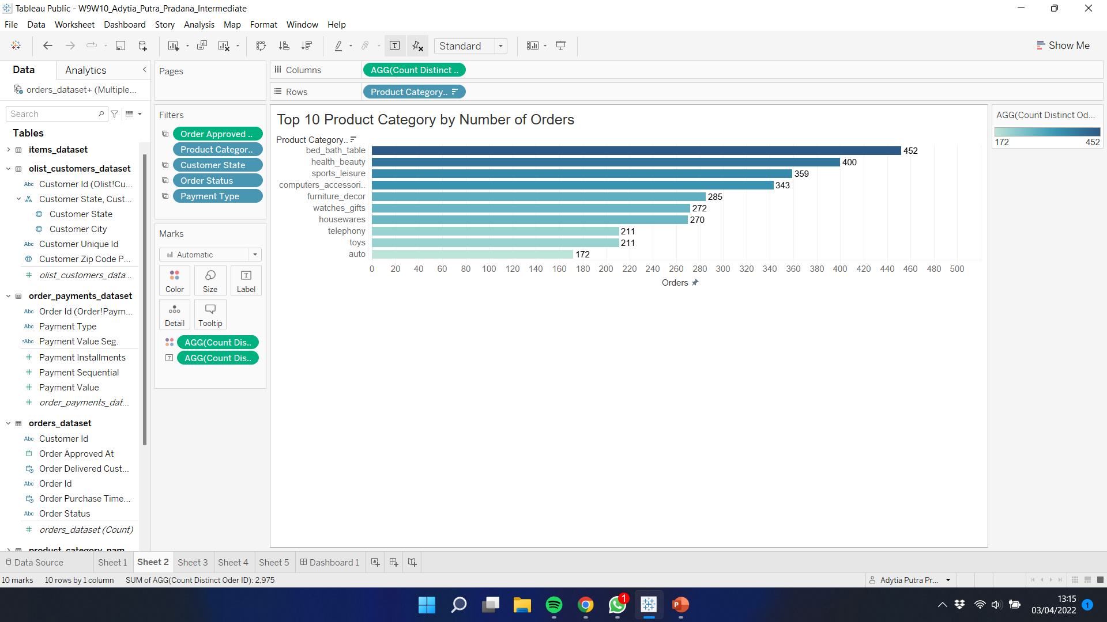
#2 – Number of Orders per Product Category
7
Of the product categories that are in the top 10 based on the number of orders, Bed Bath Table ranks first with 452 orders, followed by Health Beauty in second place with 400 orders, and Sports Leisure in third place with 359 orders.

Slide 8

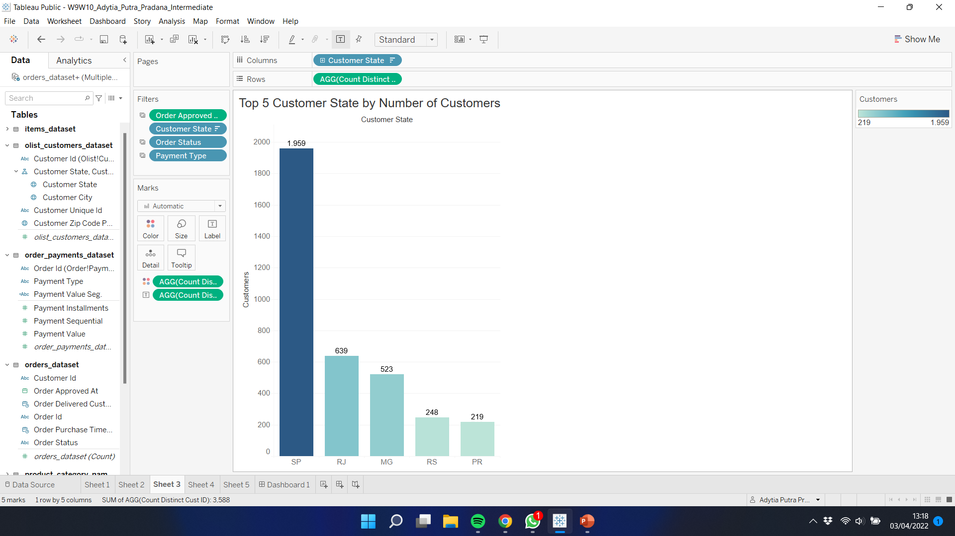
#3 – Top 5 Highest States by Number of Customers
8
Of the customer states that are in the top 5 rankings based on the number of customers, SP (Sao Paolo) ranks first with 1,959 customers, followed by RJ (Rio de Janeiro) in second with 639 customers, and MG (Minas Gerais) in third with 523 customer.

Slide 9
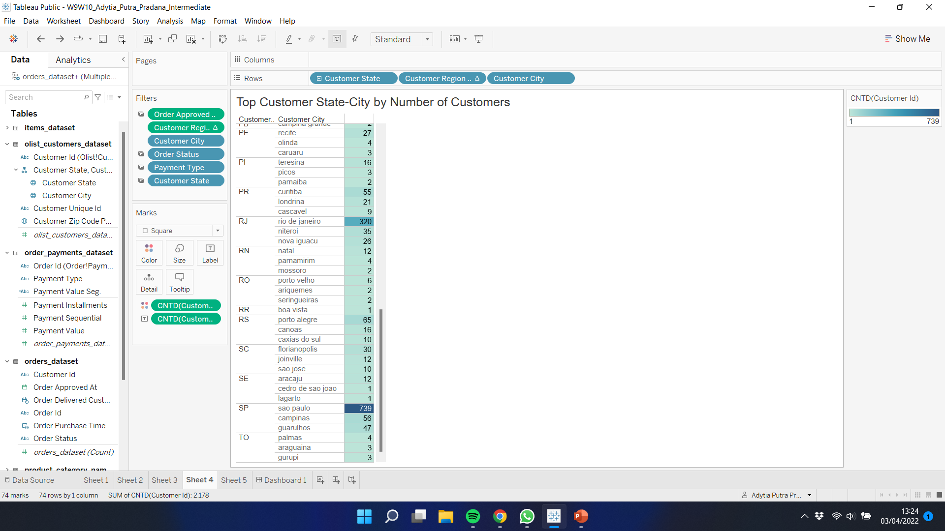
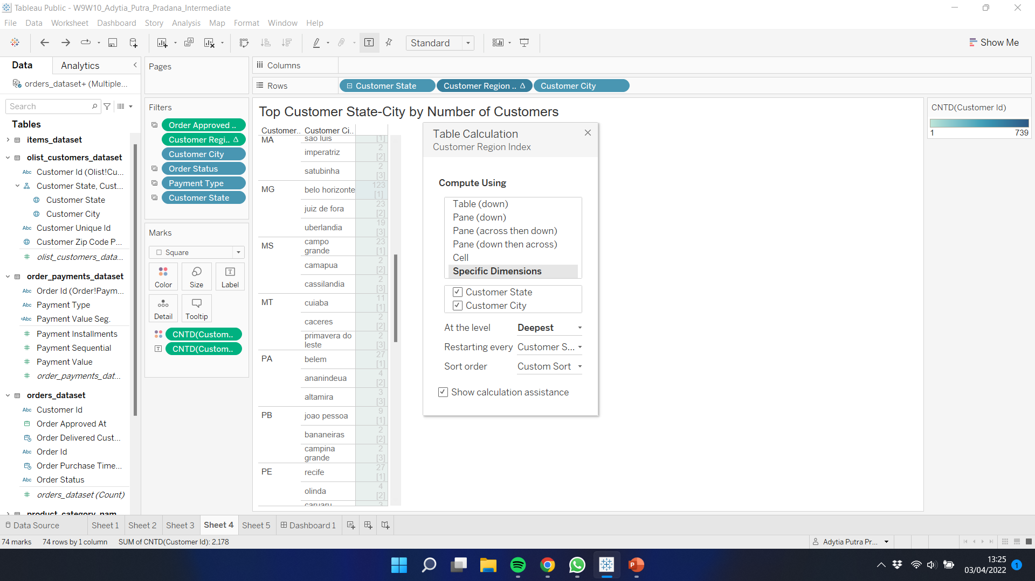
#4 – Number of Customer per Hierarchy State-City
9
In this visualization, sorting is used with a custom index at the deepest level. Sorting will order the top 3 Customer City and will repeat in each Customer State. Sorting is done based on the count of the unique Customer ID.

Slide 10
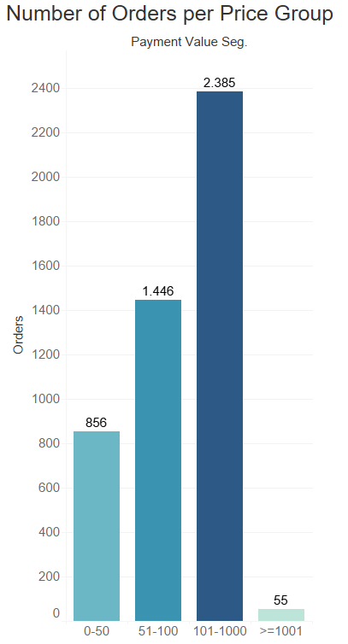
#5 – Number of Orders per Price Group
10
Segmenting is carried out on the Payment Value from the Order Payments Dataset. Price group is divided into 4, 0-50 (low), 51-100 (medium), 101-1.000 (high), and >= 1001 (very high). The price group with the highest demand is the high price group with a price range of 101-1.000 which has a total order of 2.385.

Slide 11

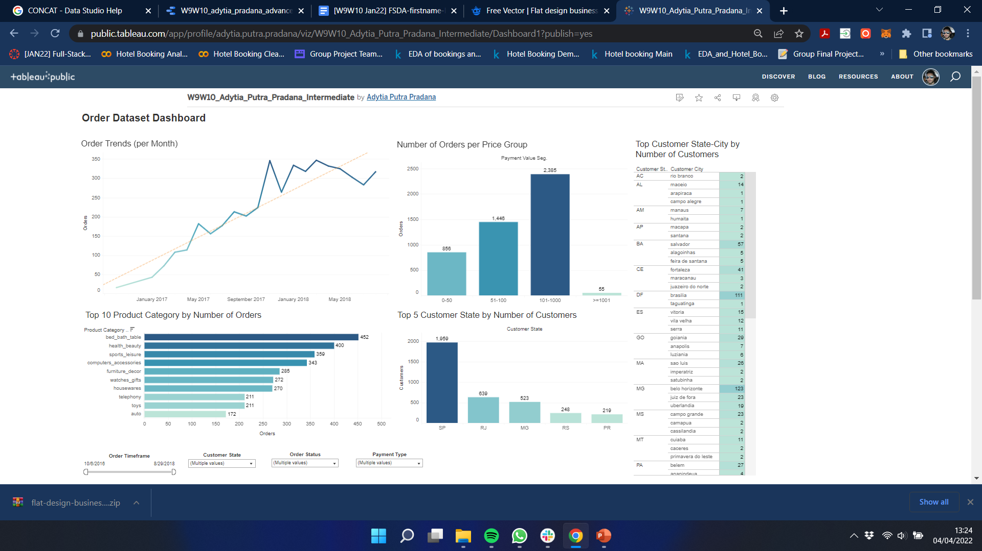
Dashboard
11
Link :
https://public.tableau.com/views/W9W10_Adytia_Putra_Pradana_Intermediate/Dashboard1?:language=en-US&publish=yes&:display_count=n&:origin=viz_share_link

Slide 12

Advanced
W9W10 FSDA Barcelona
Adytia Putra Pradana

Slide 13
Data Acquisition
13
The dataset only consist of 1 tables, the AirBnB Listings, here are the field description :
Field | Type | Description
id | integer | Airbnb's unique identifier for the listing
name | text | Name of the listing
host_id | integer | Airbnb's unique identifier for the host/user
host_name | text | Name of the host. Usually just the first name(s).
neighbourhood | text | Location.
neighbourhood_group | text | Location group.
latitude | numeric | Uses the World Geodetic System (WGS84) projection for latitude and longitude.
longitude | numeric | Uses the World Geodetic System (WGS84) projection for latitude and longitude.
property_type | text | Self selected property type. Hotels and Bed and Breakfasts are described as such by their hosts in this field
room_type | text | [Entire home/apt|Private room|Shared room|Hotel]
price | currency | daily price in local currency
minimum_nights | integer | minimum number of night stay for the listing (calendar rules may be different)
number_of_reviews | integer | The number of reviews the listing has
last_review | date | The date of the last/newest review
calculated_host_listings_count | integer | The number of listings the host has in the current scrape, in the city/region geography.
reviews_per_month | numeric | The number of reviews the listing has over the lifetime of the listing
availability_365 | integer | avaliability_x. The availability of the listing x days in the future as determined by the calendar. Note a listing may not be available because it has been booked by a guest or blocked by the host.
number_of_reviews_ltm | integer | The number of reviews the listing has (in the last 12 months)
license | text | The licence/permit/registration number
Dataset Source

Slide 14
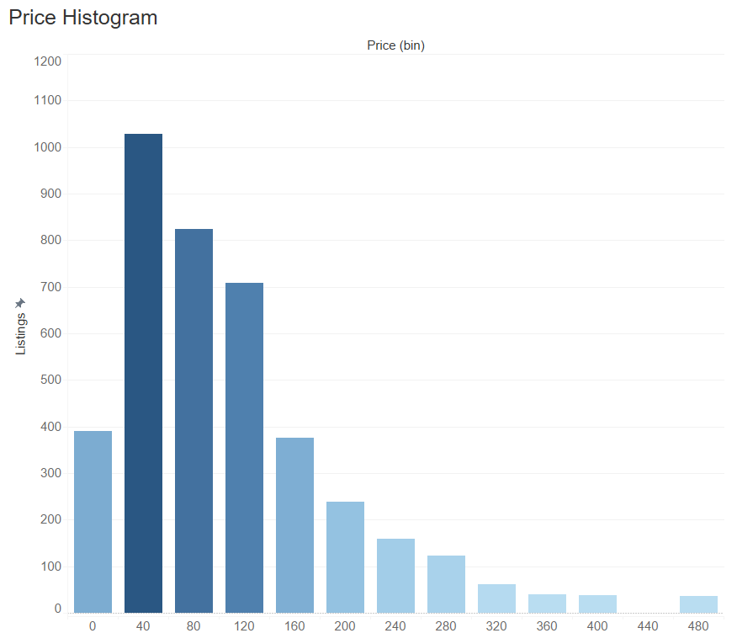
Price Data Distribution
14
In this visualization, price data that has gone through the binning process is visualized, a histogram is made and it can be seen that the data is not evenly distributed, the histogram shows a positive skewness, and the most frequent price data are in the price range 40-80.

Slide 15
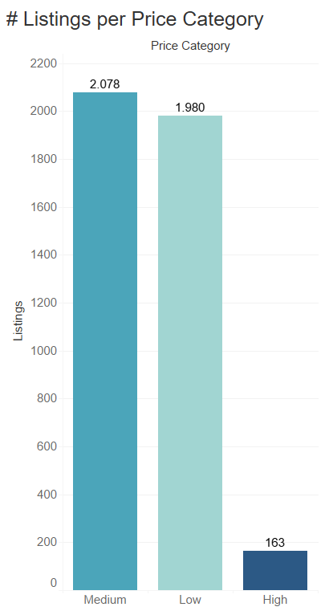
Price Data Distribution
15
In this visualization, price data that has gone through the segmentation process (calculated field) is visualized, it can be seen that from the data, the most frequent price category is medium (101-1.000), thinly behind is low (0 – 100), and last is high (>= 1.001)

Slide 16
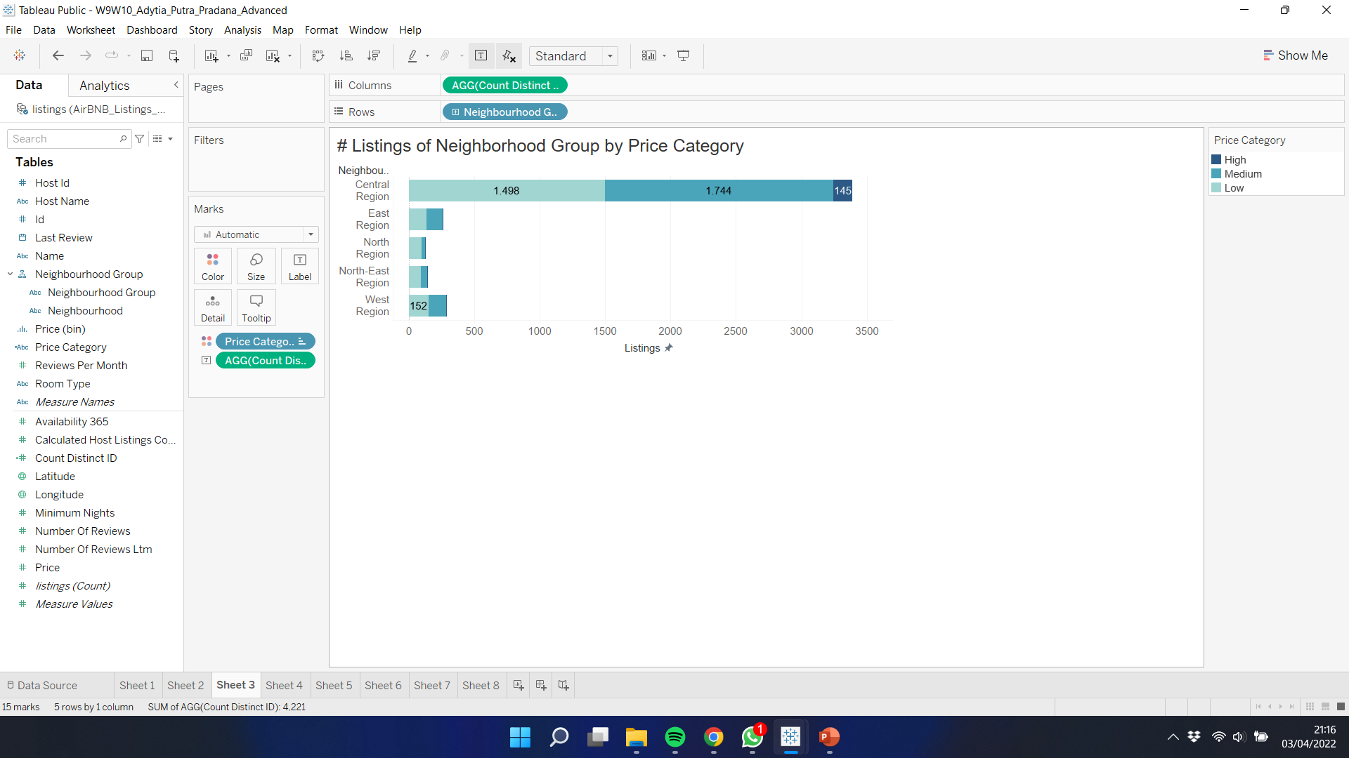
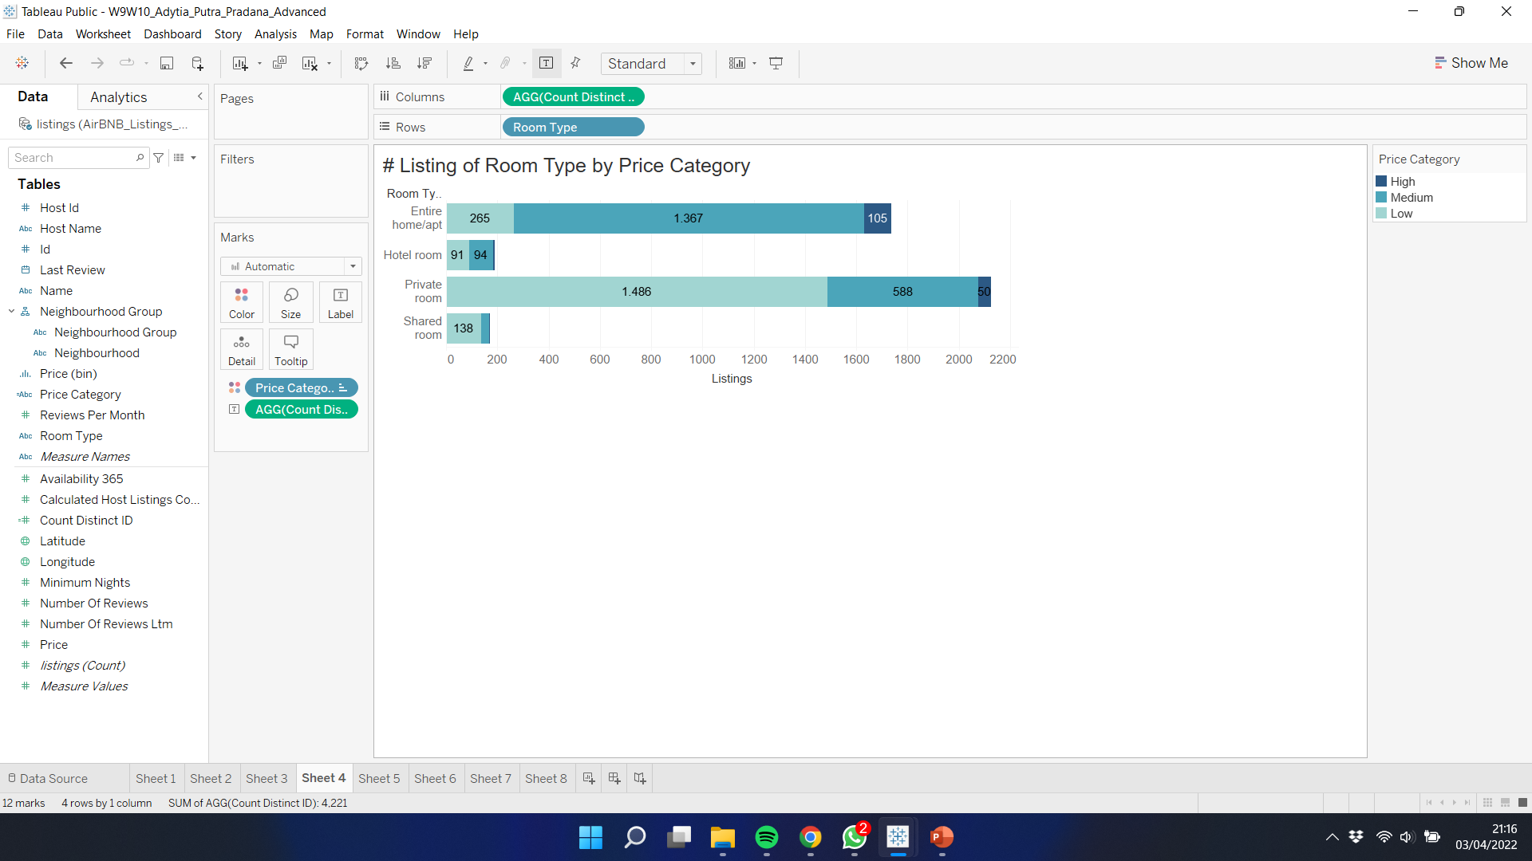
EDA Visualization
16
It can be seen that from the neighborhood group visualization of the total listings divided by price category, Central Region is the neighborhood group with the most total listings.
It can be seen that from the room type visualization of the total listings divided by price category, Private Room is the room type with the most total listings.

Slide 17
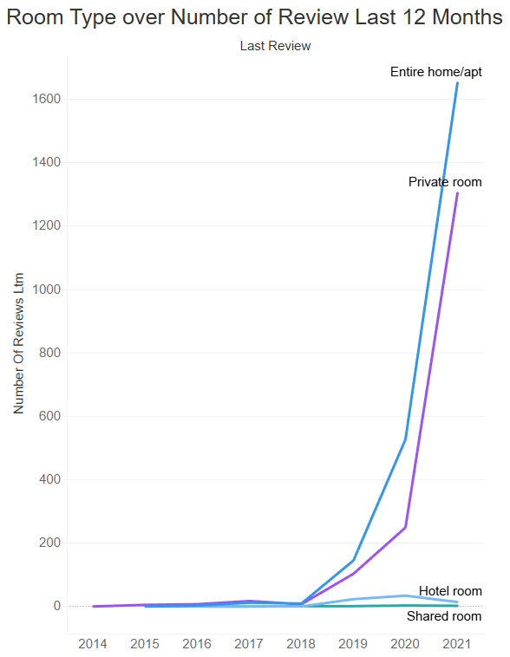
EDA Visualization
17
Over the year, I visualize the room type over their respective number of review last 12 Months. The most frequent room type reviewed is entire home/apt, followed by private room, hotel room, and last is shared room.

Slide 18

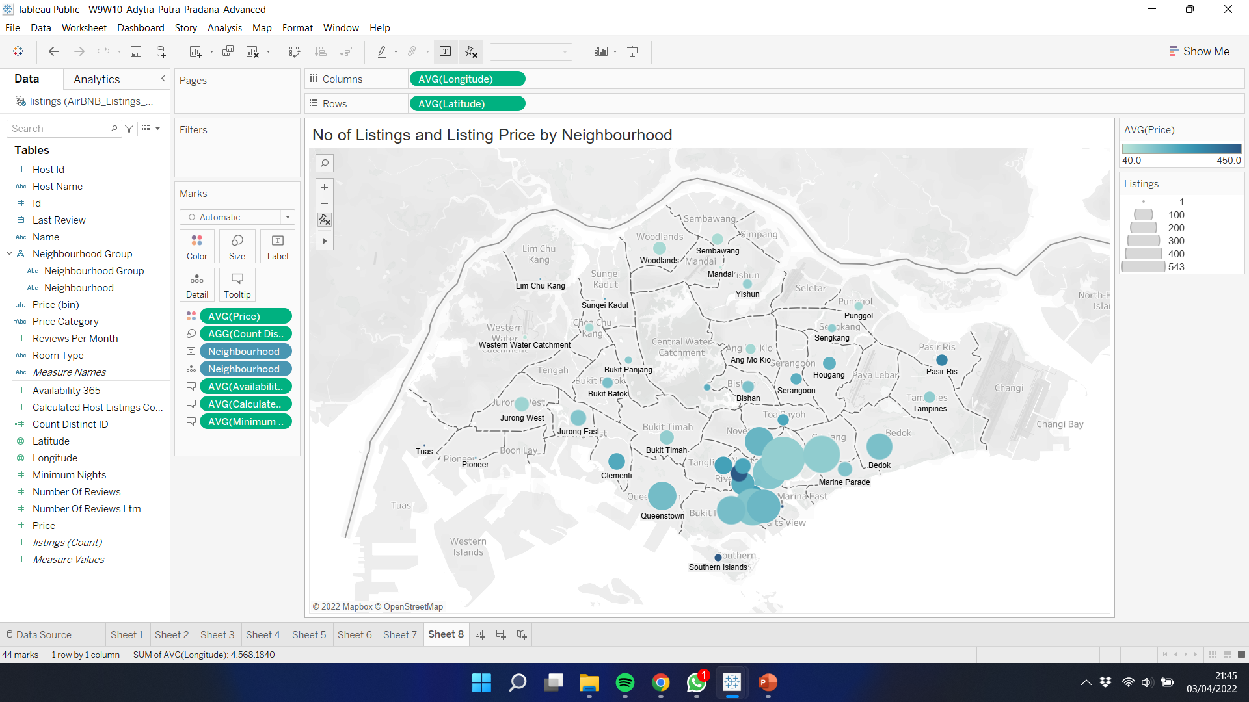
EDA Visualization
18
In this visualization, I plot the neighborhood based on longitude and latitude data. I choose to add coloring and size difference to provide more information in the visualization. The darker the color the more expensive the neighborhood is. The bigger the size, the more frequent neighborhood listed.
The most expensive neighborhood is Tuas and overall most neighborhood located in Central Region.

Slide 19
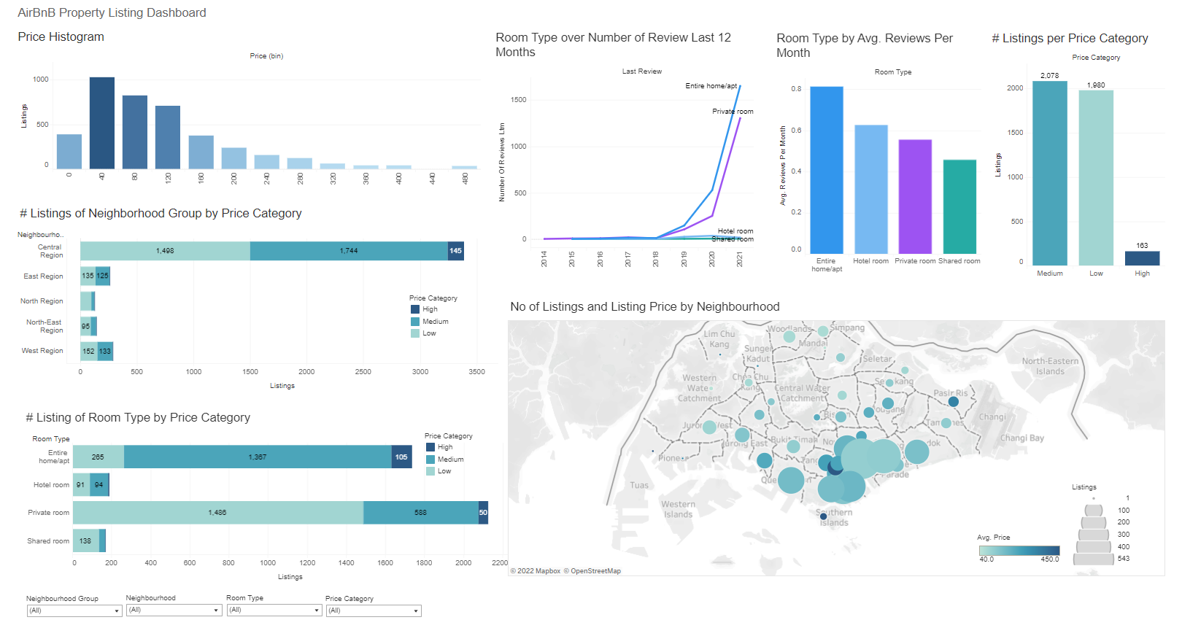
Dashboard (Tableau)
19
Link :
https://public.tableau.com/views/W9W10_Adytia_Putra_Pradana_Advanced/Dashboard1?:language=en-US&publish=yes&:display_count=n&:origin=viz_share_link

Slide 20
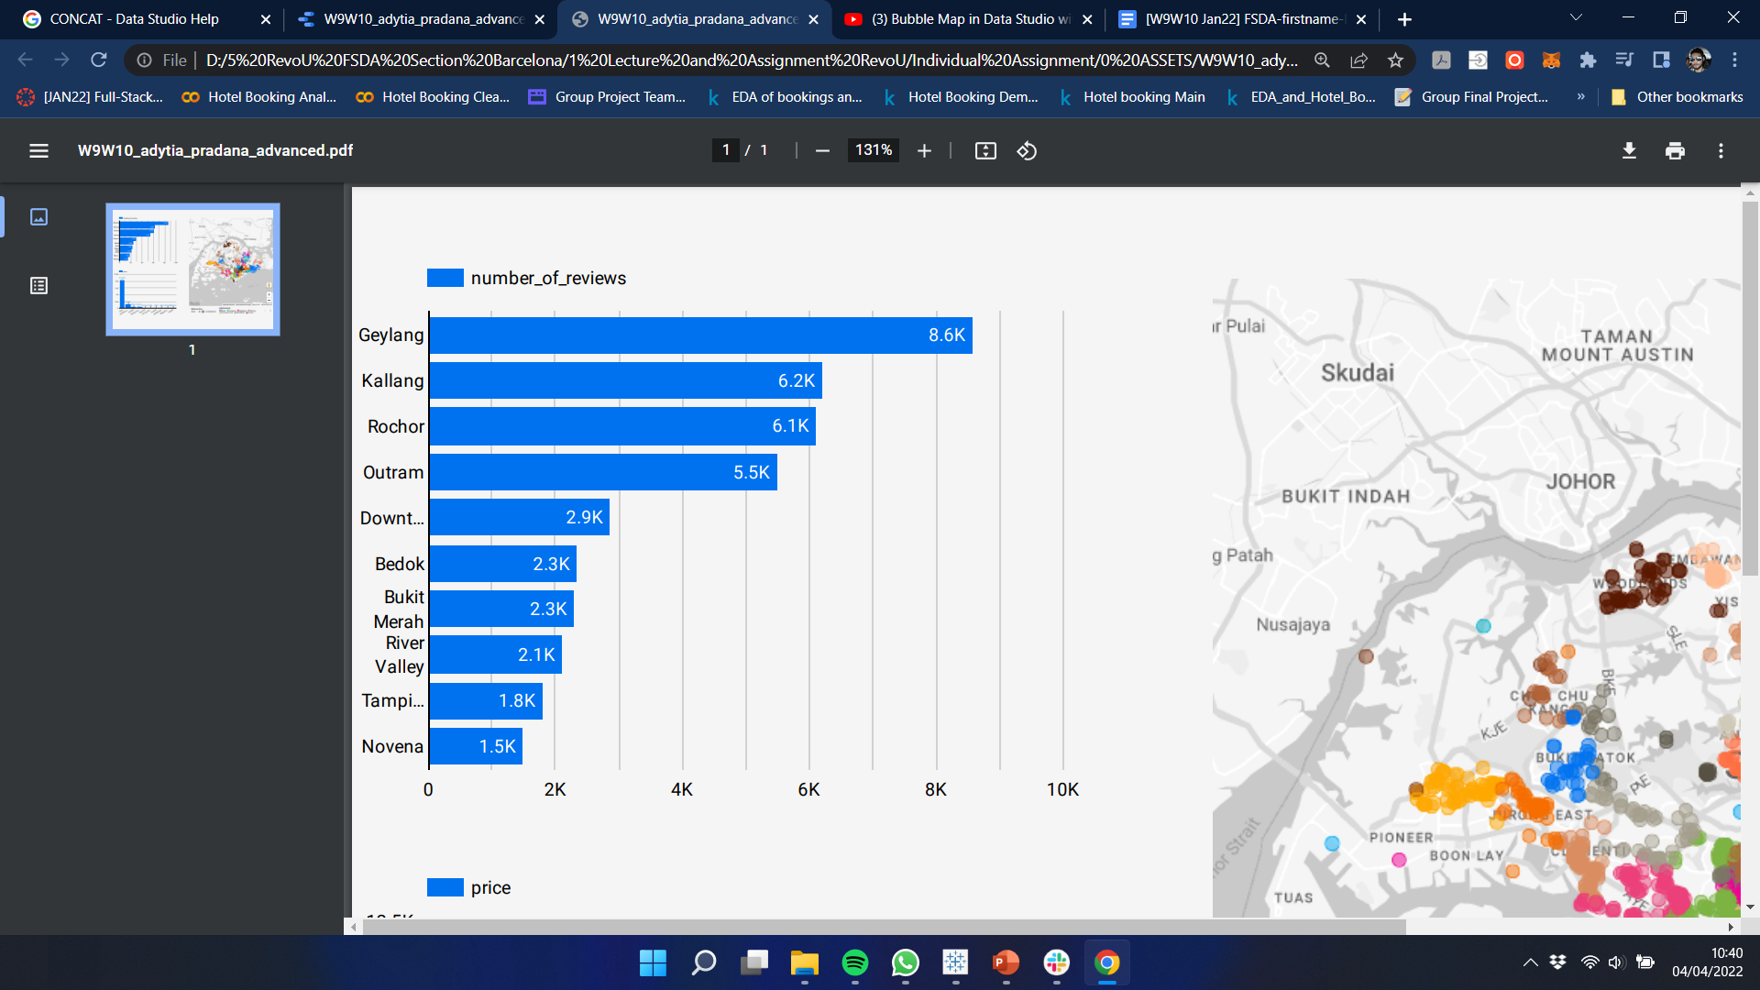
EDA Visualization (GDS)
20
Number of Reviews per Neighborhood
From the chart, we can see that neighborhood with highest number of reviews is Geylang with 8.600 reviews, followed by Kallang with 6.200 reviews, and followed closely by Rochor with 6.100 reviews.

Slide 21
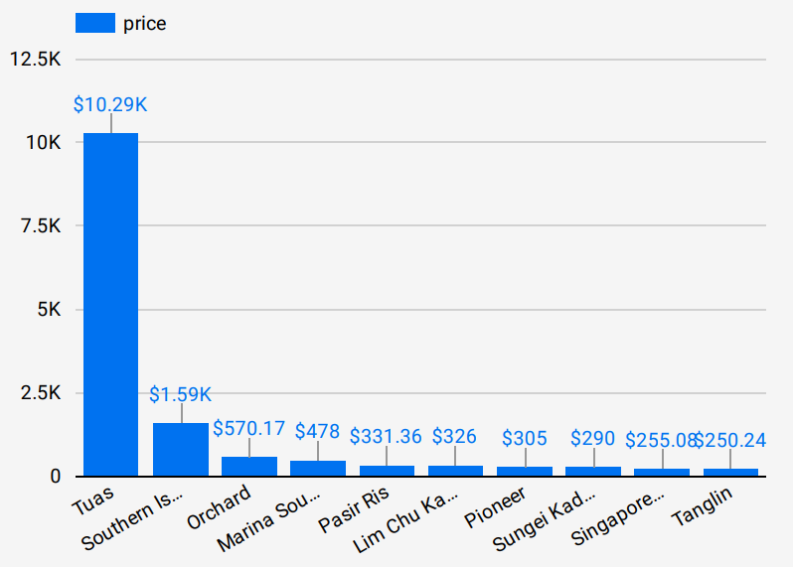
EDA Visualization (GDS)
21
Average Price per Neighborhood
From the chart, we can see that neighborhood with highest average price is Tuas with average price of $10,29K SGD, followed by Southern Island with average price of $1,59K SGD, and then Orchard with average price of $570,17 SGD.

Slide 22
EDA Visualization (GDS)
22
In this visualization, I plot the name of listing based on Geodata (using calculated field by concatenate latitude and longitude field). I choose to add coloring based on their respective neighborhood and size difference based on min price (using calculated field by multiplying price and min nights) to provide more information in the visualization. The bigger the size, the minimum price is higher.
The most expensive listing is Corner Terrace located in Bedok with minimum price of $1.825.000 SGD.

Slide 23
Dashboard (GDS)
23
Link :
https://datastudio.google.com/reporting/7b77240d-11bb-466e-bf72-2fbb2b30d96e

Slide 24

TERIMA KASIH !
24
THANK YOU!

